Slide 1
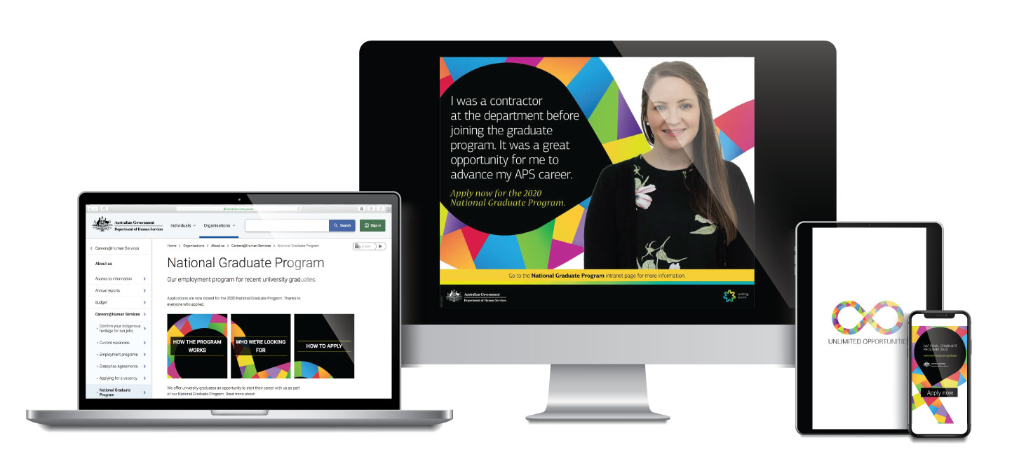
Department of Human Services National Graduate Program
Integrated
Marketing Campaign
2019

Slide 2
The Department of Human Services recruits approximately 100 graduates
each year to participate in
the National Graduate Program.
The Program aims to identify and grow future talent and maintain succession for critical jobs.
Notes:
Title

Slide 3
Our unique selling proposition
We know that millennials are defined by their mobility. They are a multi-career generation, swapping jobs every 3-4 years¹.
We want them to know they can go through career shifts within the one organisation. Due to our sheer size and variety of disciplines, many of our existing employees already enjoy a long-term career with us.
We offer opportunities for internal mobility and career change without ever having to find a new employer.
1 Motivating Millenials Report, Kronos Incorporated

Slide 4
The recruitment goals
Highlight the benefits of working for the department and attract the best graduates to apply.
Achieve a high volume of quality applications including meeting organisational objectives for Affirmative Measures Indigenous and Disability.
Identify and recruit the capabilities, competencies and values needed to achieve our recruitment goal.

Slide 5
The visual
The overall design uses a combination of vibrant colours and strong graphical elements intended to create a campaign that is memorable and eye catching to the demographic whilst maintaining the corporate professionalism of the department.
The bright colours attract attention. The black background is used to create a bold contrast to bring attention to the design element and primary information.
Colours used have been taken from the department’s theme palette.
Notes:
Title

Slide 6
The visual
Main graphical element of an infinity loop is used which represents the unlimited opportunities graduates are exposed to in our department.
The visual element is enhanced by the tagline —One Department. Unlimited Opportunities.
Both have been carried through the visual collateral and content associated with the campaign.
This has been styled with ‘on trend’ geometric shapes with each segment also representing unlimited opportunities. The gradient of each segment is used to depict movement and the overall shape can be indicative of graduates journey within the department.

Slide 7
The visual
It is supported by selected images of graduate talent in case studies, editorials and on the National Graduate Program web page.
Hardcopy collateral does not feature images of graduates. This approach is geared to a digital first environment and allows more flexibility in the creative application especially with limited real estate across online and social media channels.

Slide 8
The strategy
We leveraged and built on our
strong social media presence.
We honed and re-targeted our
media channels to their best advantage
with excellent results.
We focused heavily on stories
from existing graduates.

Slide 9
Our marketing channels
Online Advertising
Internal Marketing
Direct Marketing
Intranet Articles
SEO
Careers
Fairs
Postcards
Job
Sites
Display
and
mobile
Yammer: Word of Mouth
Screensaver
Advertising
Social Media
Print
Advertising
Indigenous
Press
Facebook
Instagram

Slide 10
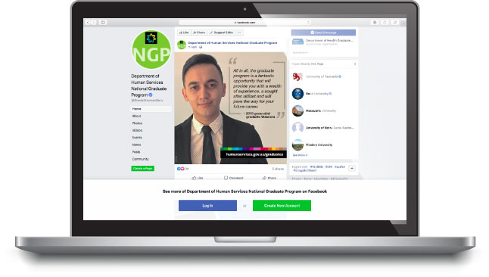
Facebook
Facebook continues to be the key channel we use to engage with potential applicants. We leveraged our strong Facebook presence that has been built over the years. Our dedicated National Graduate Program Facebook page has over 13,500 likes and just under 4,000 followers.

Slide 11
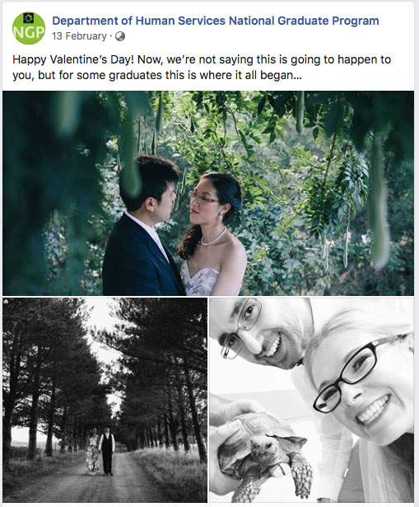
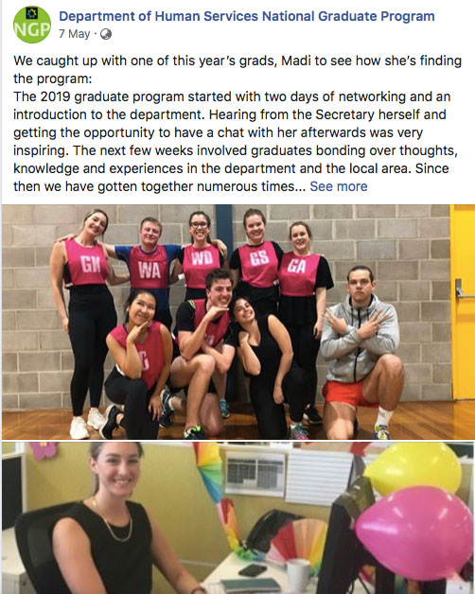
Facebook
We showcased current graduate stories, social events and, of course,
our unique Indigenous and Multicultural Placement.

Slide 12
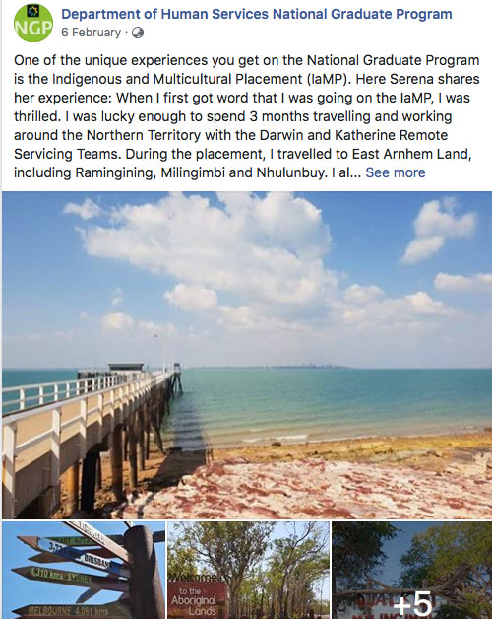
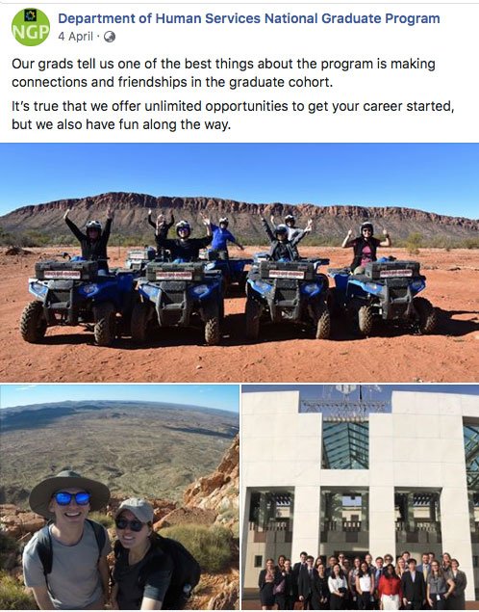
Facebook
Our Indigenous and Multicultural Placement is a highlight of our
National Graduate Program. Current graduates apply to spend 3 months experiencing the work undertaken by our teams in remote Indigenous communities.

Slide 13
Facebook results
9,649
click throughs
677,193 impressions
(more than double
2018 numbers)
237 new likes
Messaging about wanting to make a difference
hit a chord

Slide 14
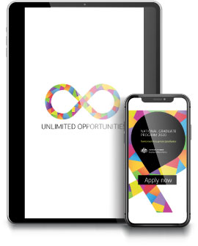
Instagram Stories
Based on the success of Facebook and the high use of Instagram by the target market, we decided to invest in advertising using Instagram stories…

Slide 15
Instagram Stories
Press
play

Slide 16
Instagram - results
Instagram stories advertising was more successful that Facebook advertising, and we only ran it for 2 weeks.
869
click
throughs
234,942 impressions

Slide 17
Website
The National Graduate Program web page was a key online presence during our campaign.
The web page content covered how to apply, application process, key information about relocations and living in Canberra. We also featured profiles and experiences of current graduates across the various disciplines we recruit for.

Slide 18
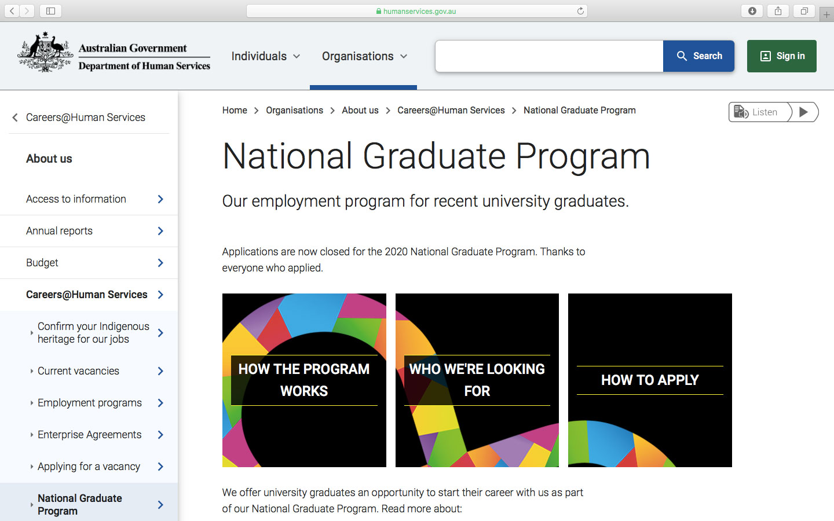
Website

Slide 19
Website - results
41,758
visits
677,193 impressions
An increase of 28% visits to the NGP landing page
()

Slide 20
Online advertising
We increased the number of Google search keywords from last year by 30% which gave us 1,113,828 impressions. This is an increase in over 1 million impressions from last year.
We received 7,412 click-throughs. Campaign performance was strong at driving traffic with a click-through rate of 6.51%. This is well above the government benchmark of 4%.

Slide 21
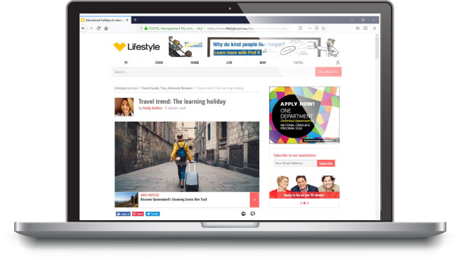
Online advertising
Big Mobile was one of the new channels that we used. We achieved a click-through rate of 0.16% which is above the benchmark of 0.05% - 0.07%.

Slide 22
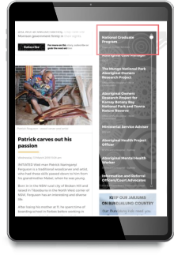
Online advertising
We used more targeted strategies to attract Indigenous applicants. This included advertising in both print and online Indigenous press.

Slide 23
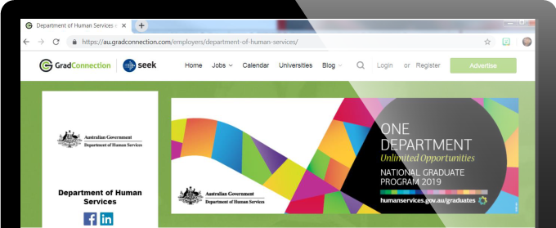
Online advertising
Compared to 2018 we achieved a 60% increase in click-throughs from job boards from last year and a 53% increase in click-throughs from graduate websites.

Slide 24
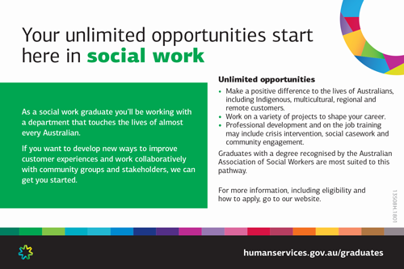
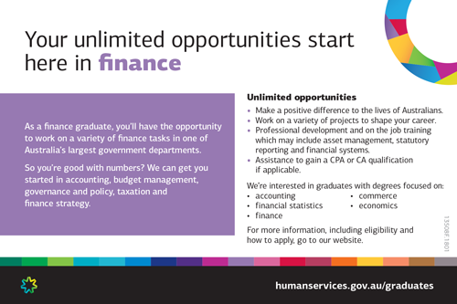
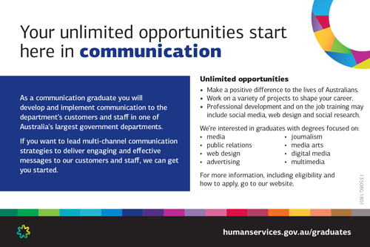
Direct Marketing – Collateral
The Department of Human Services is committed to the appropriate use of Government expenditure. We are mindful of ensuring our promotional products are efficient but effective in promoting the National Graduate Program.
We distributed 2,089 discipline-specific postcards and designed lollipop signs for Career Fairs. This promotion resulted in 3,000 applications for the 2020 National Graduate Program.

Slide 25
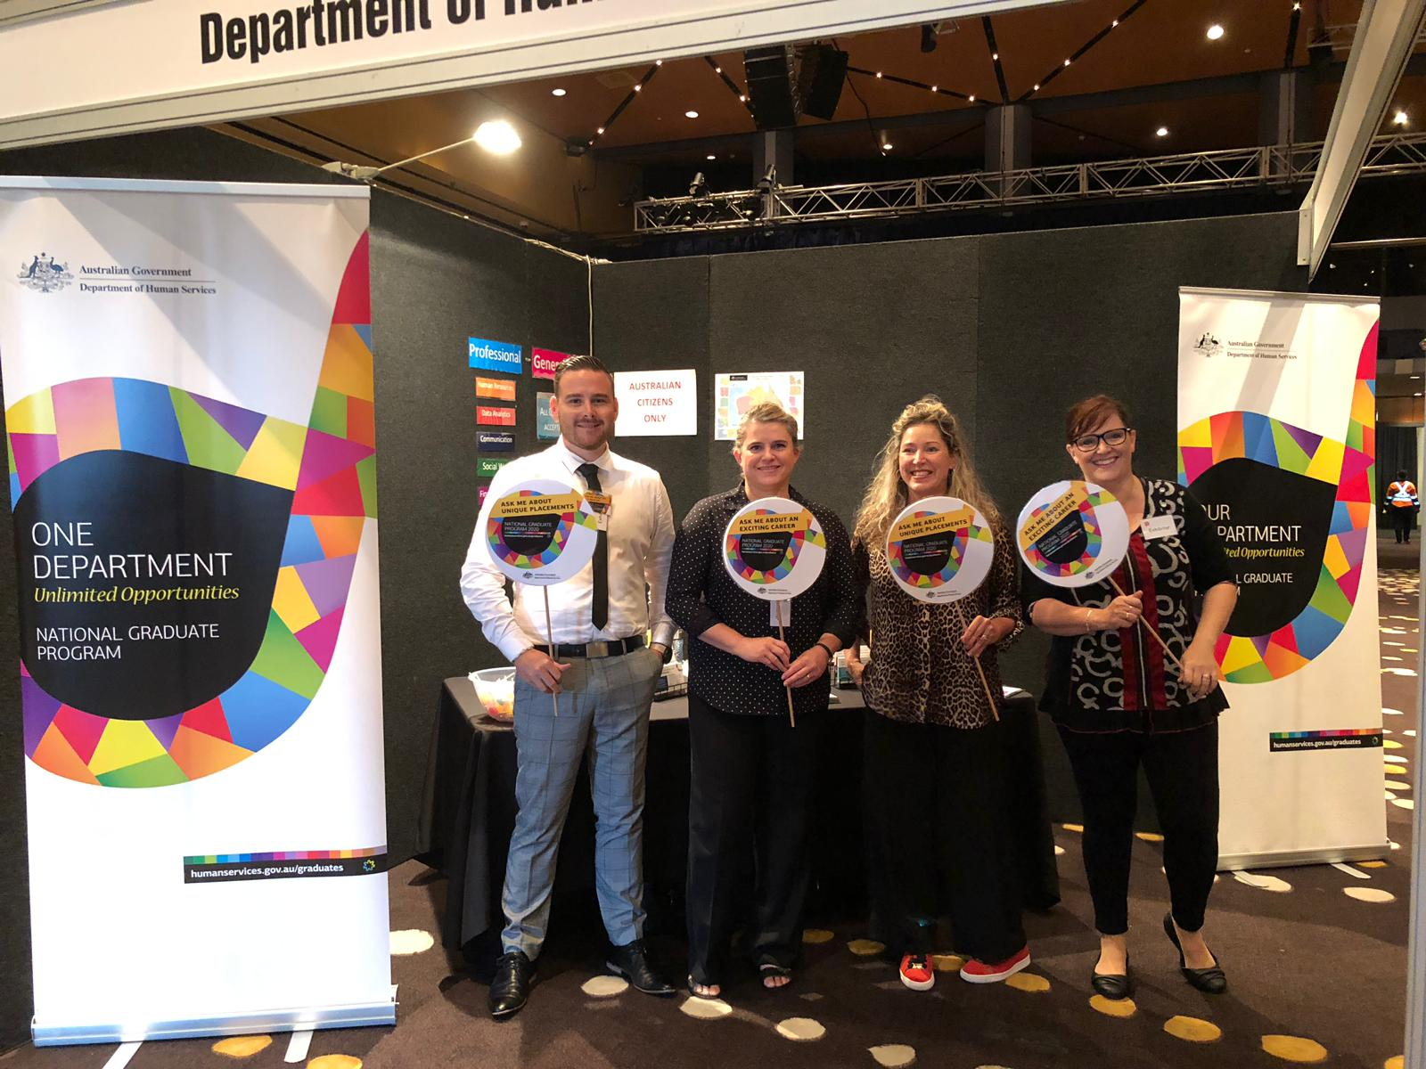
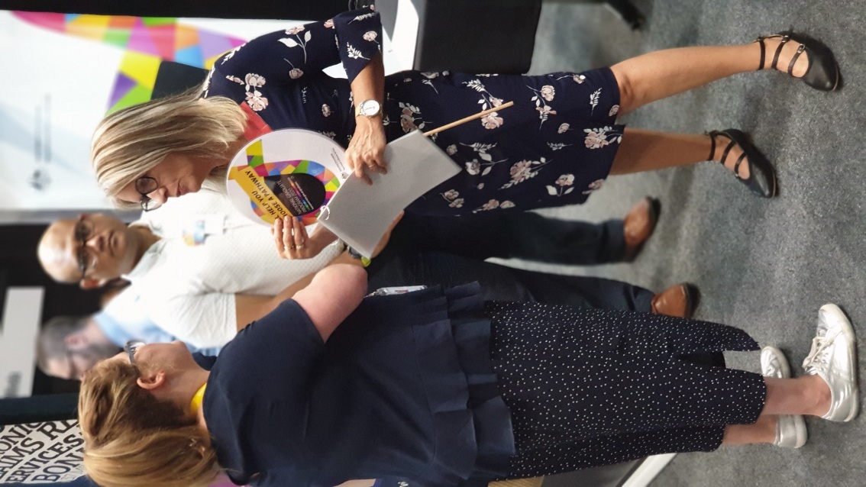
Direct Marketing – Collateral
The lollipop signs were excellent ice breakers and were successful in drawing potential applicants to our booths.

Slide 26
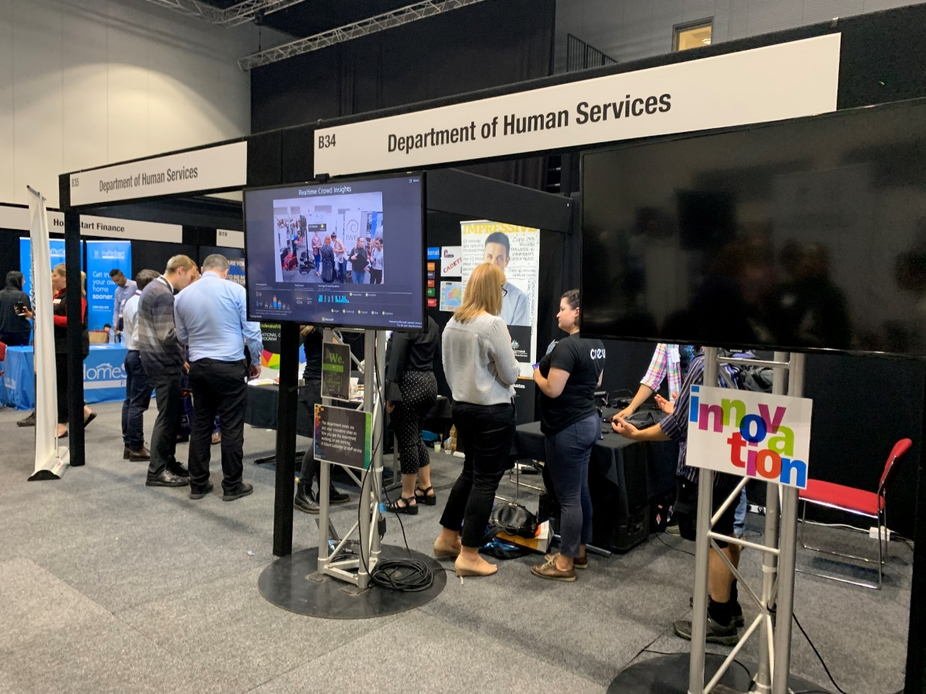
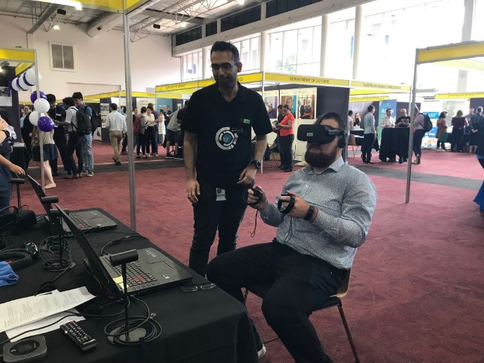
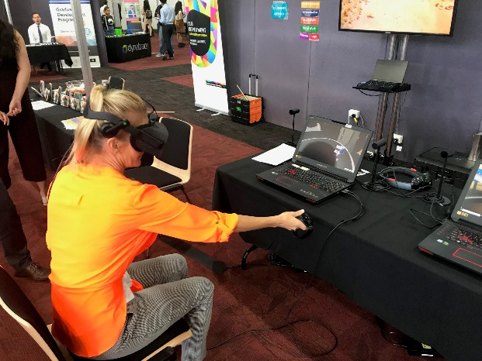
Careers Fairs - Collaboration
We invited our Technology Innovation Centre to join our career fair booths to exhibit their virtual reality technology.
This was another way to showcase the innovation our department has to offer.

Slide 27
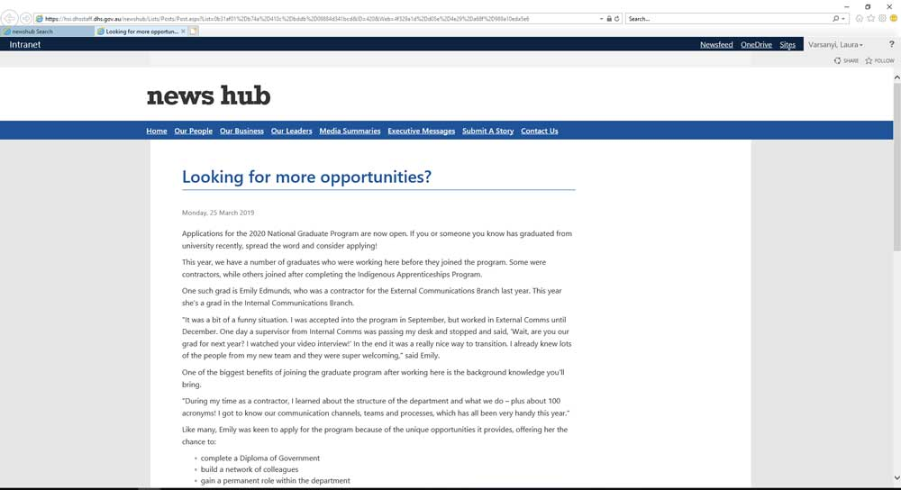
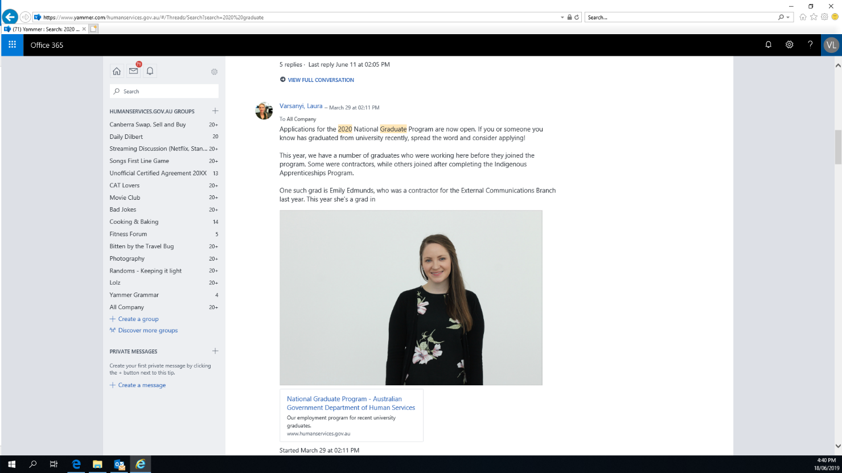
Internal Advertising
We advertised internally to our 35,000-strong employee base, inviting applications and asking them to let friends and family know that applications are open.

Slide 28
Internal Advertising
This year we profiled a current graduate who applied for the National Graduate Program whilst working as a contractor for the Department of Human Services in 2018.
We posted the article to our internal News Hub, Yammer sites,
and advertised their story via a screensaver.

Slide 29
Campaign success
Campaign performed well and achieved better results than previous years.We used 2 new channels – Instagram stories and Big Mobile.
We also used more targeted strategies and creative on social media.
While the targeted posts cost more per click –
we delivered messaging that resonates with the target audience- this resulted in a higher click through rate.
We received over 3000 applications
…an increase of 10% on last year…
…and an increase of 25% on our 2017 process.

