Slide 1
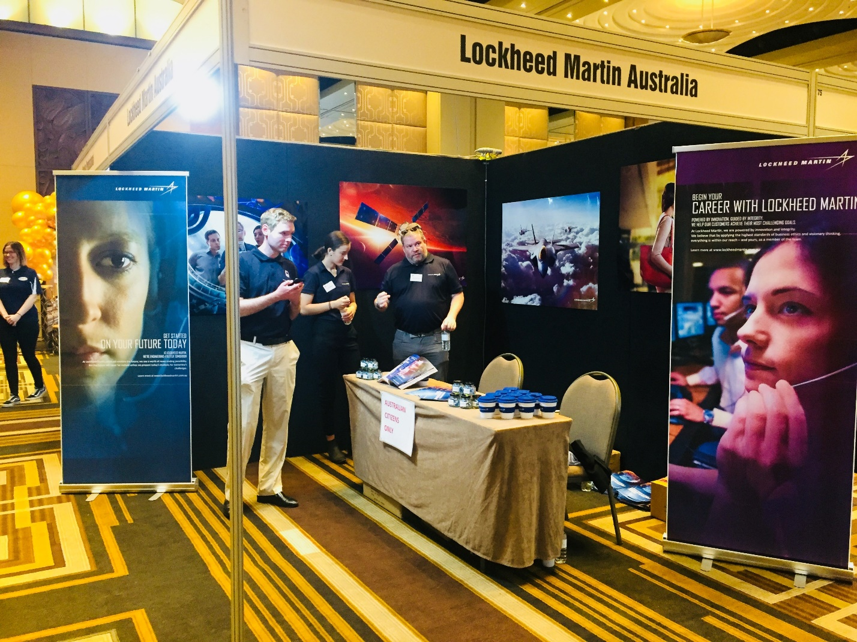
The ‘Big MEET’ Melbourne

Slide 2
Adelaide university careers expo

Slide 3
Flinders University Joblink Summit

Slide 4
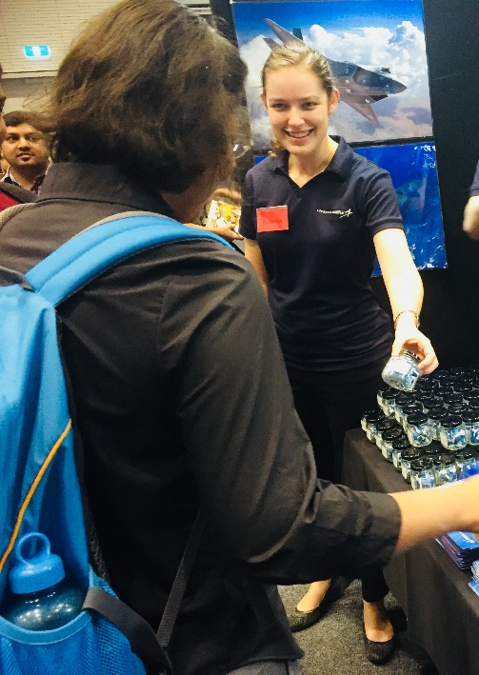
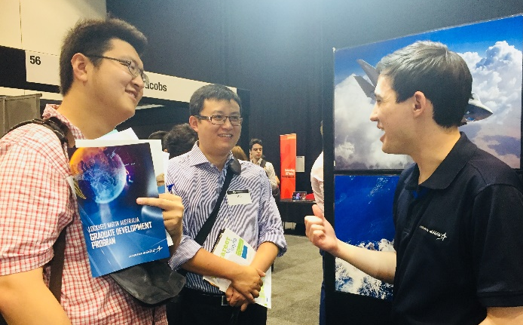
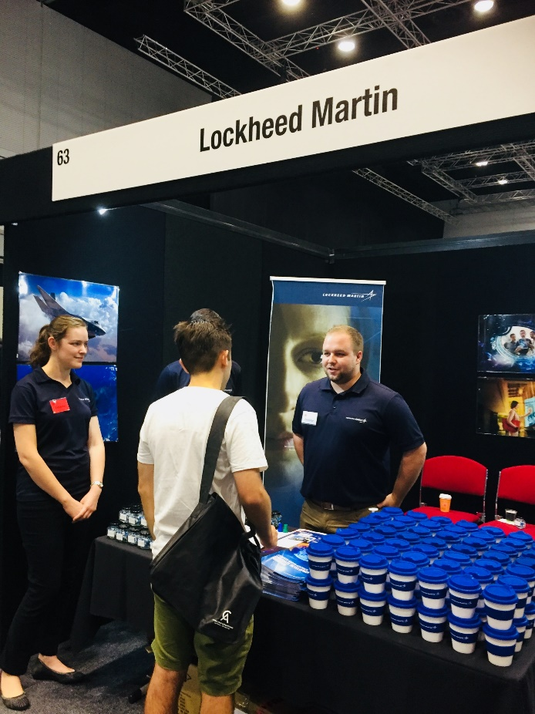
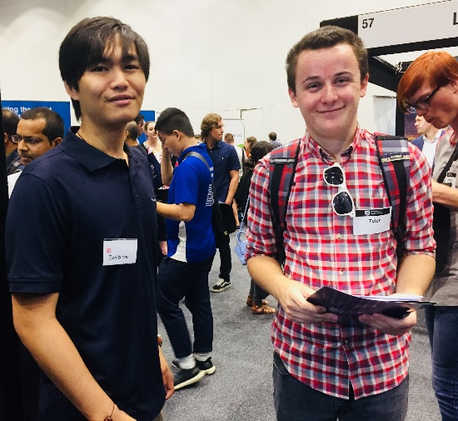
The Big Meet Adelaide (UniSA)

